Slide 1
DESIGN AND FABRICATION OF AN IMPROVED INDIRECT EVAPORATIVE COOLER

Slide 2
TEAM MEMBERS :
SHRIYASH MHASKAR | MANDAR BRID
JATIN PANCHAL | ROHIT KADAM
VIGHNESH MORE | MAYUR PATIL
FACULTY ADVISOR : DR. KAVITA H. DHANAWADE

Slide 3
THERMAL COMFORT
1

Slide 4
THERMAL COMFORT
Thermal comfort is the condition of mind that expresses satisfaction with the thermal environment and is assessed by subjective evaluation
Maintaining thermal comfort for occupants of buildings or other enclosures is one of the important goals of HVAC (heating, ventilation, and air conditioning) design engineers.

Slide 5
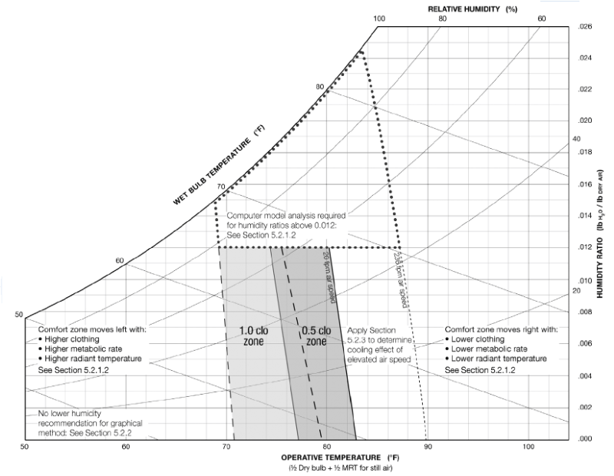
Thermal Comfort Chart – ASHRAE Standard 55

Slide 6
AIR-CONDITIONING
2

Slide 7
AIR-CONDITIONING
Air-conditioning is defined as a process which cools (or heats), cleans, circulates, freshens air and control its moisture simultaneously.
There are two types of 'Cooling': Sensible Cooling and Latent Cooling.

Slide 8
TYPES OF AIR CONDITIONING
Decentralized
Window AC
Split AC
Centralized
Variable Refrigerant Flow system
Chiller systems
DX system

Slide 9
PROBLEMS
3
Faced by traditional cooling system

Slide 10

MAJOR DISADVANTAGES
Energy consumption
Indirect release of greenhouse gases
Heat island effect

Slide 11
SOLUTION
4
Pre-Cooling of Air

Slide 12
ADVANTAGES OF PRECOOLING
Reduces Energy usage
Reduces maintenance
Extends Equipment life
Increases system reliability
Increased fresh air supply

Slide 13
WHAT WE SUGGEST

Slide 14
EVAPORATIVE COOLING
5

Slide 15
EVAPORATIVE COOLING
Evaporative cooling is reduction in temperature resulting from evaporation of liquid.
An Evaporative Cooler is a device that cools air through evaporation of water.

Slide 16
TWO APPROACHES
Direct Evaporative Cooling (DEC)
Water evaporates directly into air stream, thus reducing air temperature while humidifying the air
Indirect Evaporative Cooling (IEC)
Primary air is cooled sensibly with a heat exchanger, while secondary air carries away the heat energy from primary air as generated vapor

Slide 17
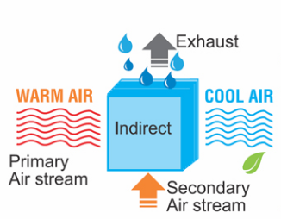
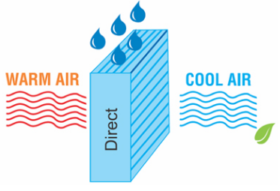
Direct Evaporative Cooling
Indirect Evaporative Cooling

Slide 18
DEC vs. IEC
Direct Evaporative Cooling
Water evaporates directly in the air stream
Air dry bulb temperature decreases
Increases humidity
Indirect Evaporative Cooling
Water evaporates in a secondary air stream
Outdoor air stream is cooled , without modifying its absolute humidity

Slide 19
PROBLEMS IN CURRENT IEC DESIGN
Inefficient distribution of water over surface
Poor wettability
Single point working air injection
Highly complex design
Sagging
Hydrophobic separation

Slide 20
DESIGN
6

Slide 21
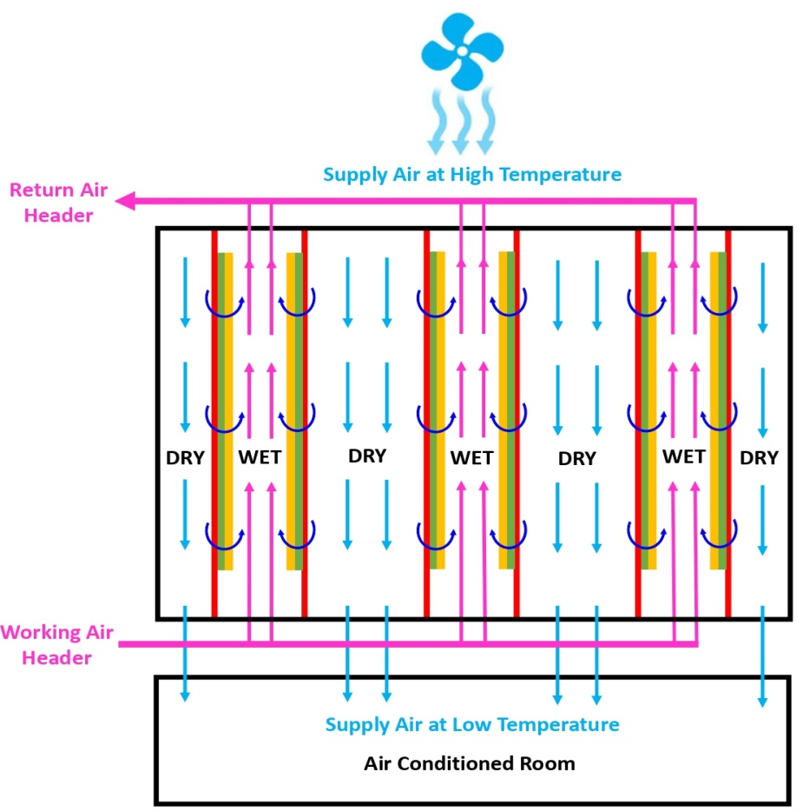
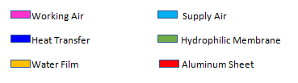
Schematic Representation of IEC.

Slide 22
DESIGN OF SYSTEM
Quick assembly and disassembly
Increase in Workability
Ease of experimentation

Slide 23
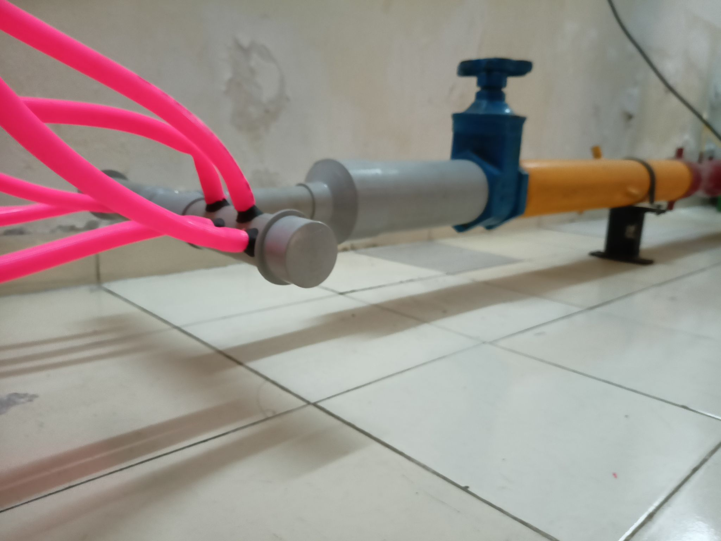
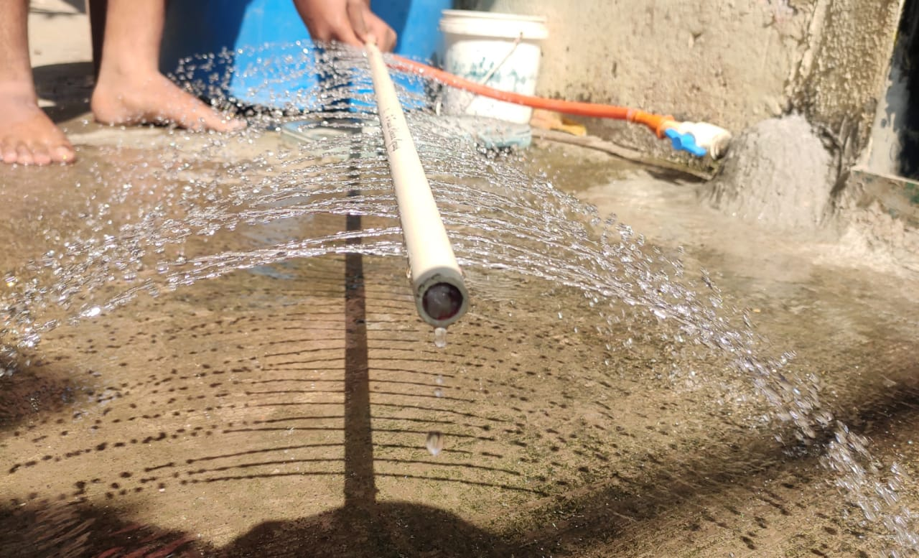
TESTING

Slide 24
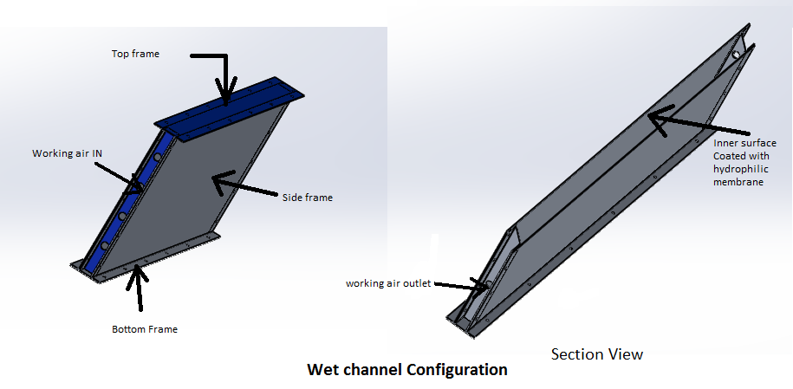
Wet channel configuration

Slide 25
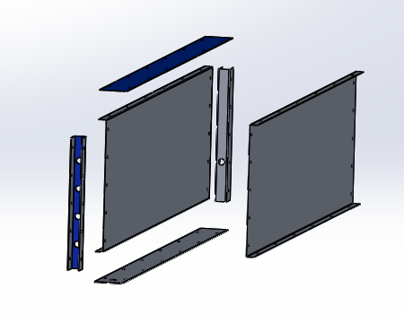
Wet Channel (Exploded View)

Slide 26
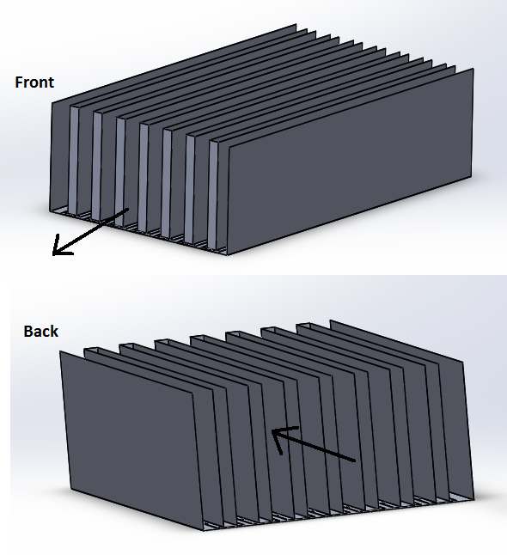
Configuration of Wet channel and dry channel

Slide 27
CURRENT PROGRESS
7

Slide 28
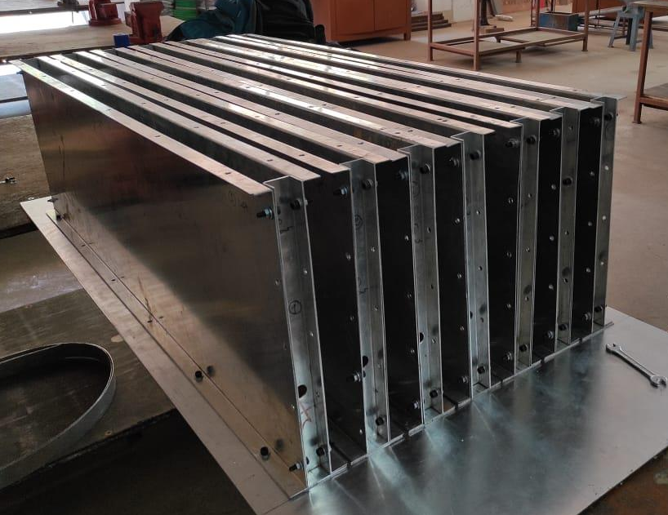
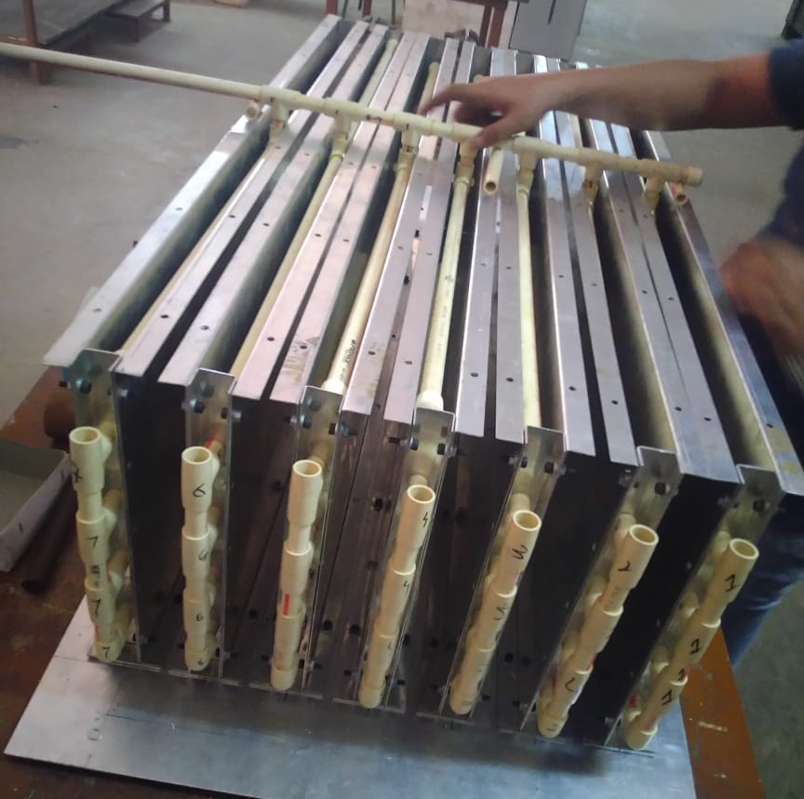

Slide 29
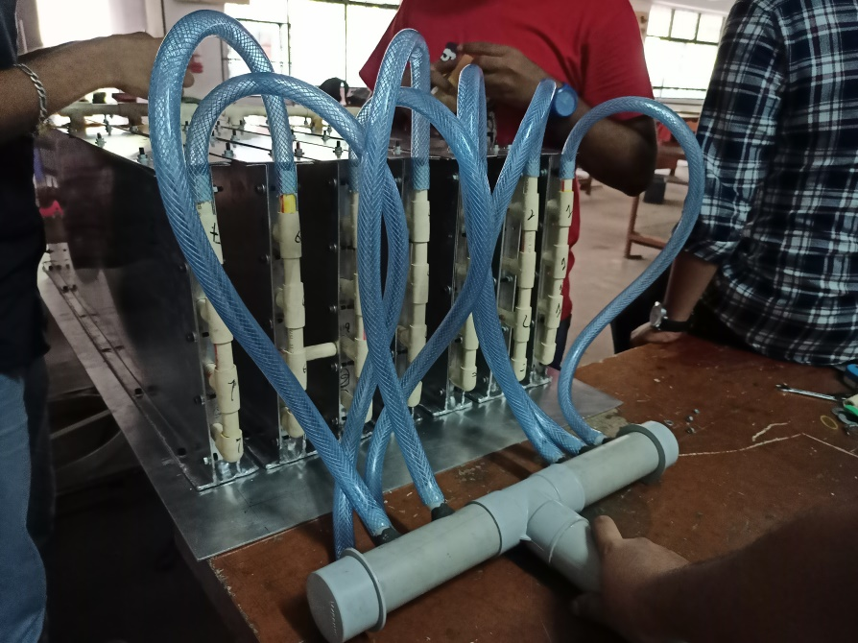


Slide 30
CFD
8

Slide 31
Assumptions
The Temperature of the Working Air was assumed to be constant.
The Temperature of working air was calculated using the Wet Bulb Effectiveness (WBE)
Supply to working air ratio = 0.5
Velocity for Working Air = 0.3 m/s
Velocity for Supply Air = 0.15 m/s
DBT of Supply Air at inlet = 31.7 °C

Slide 32
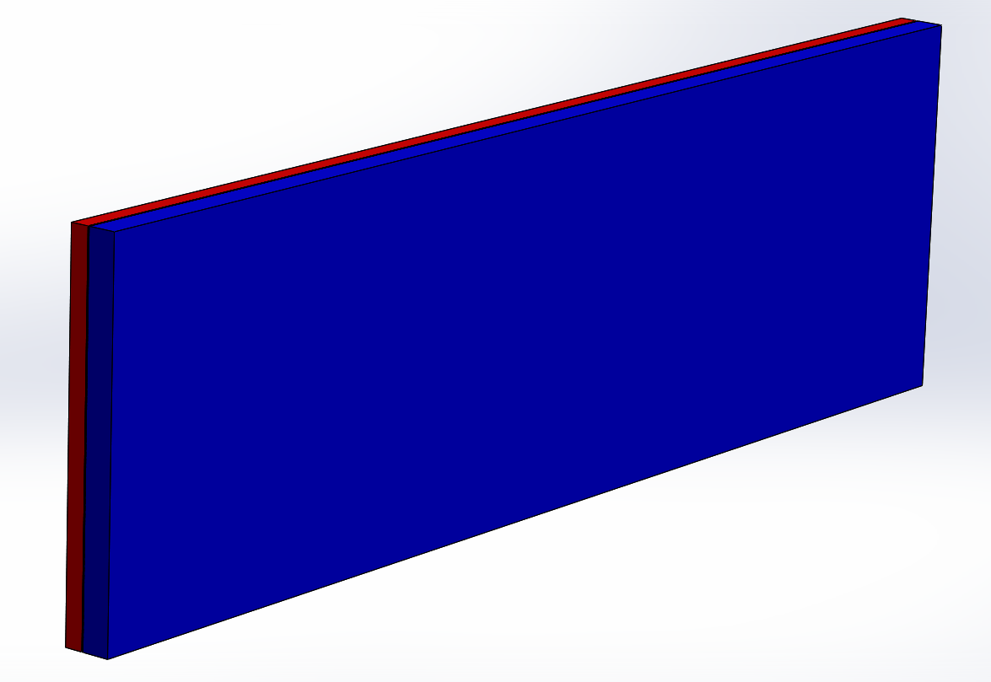
Model

Slide 33
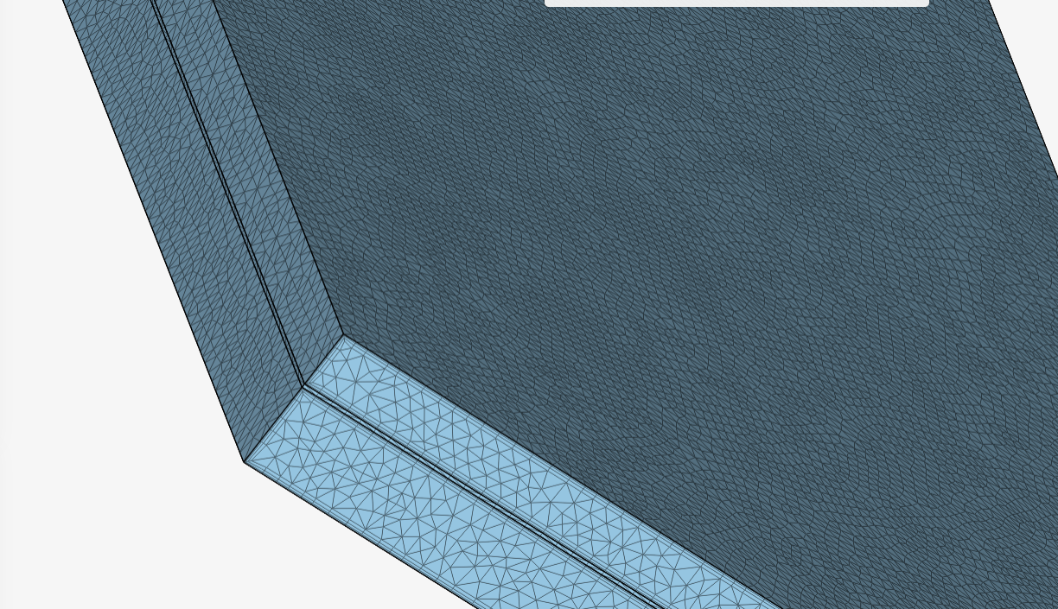
Meshing

Slide 34
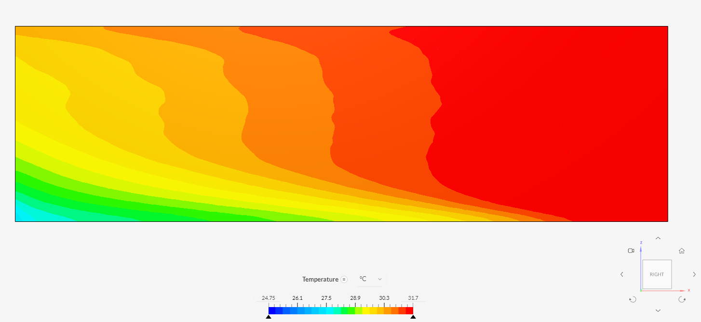
Supply Air

Slide 35
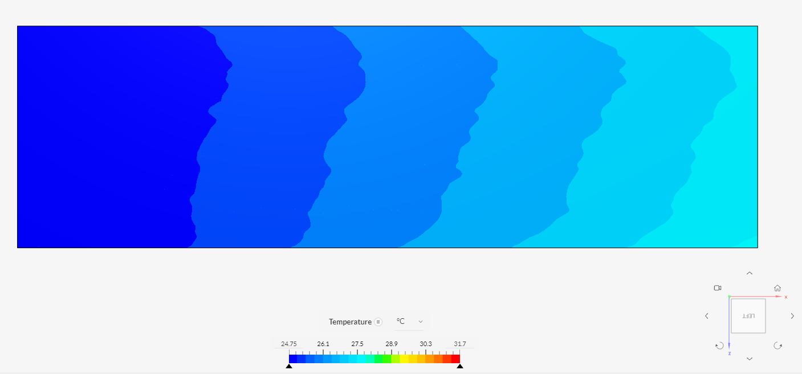
Working Air

Slide 36
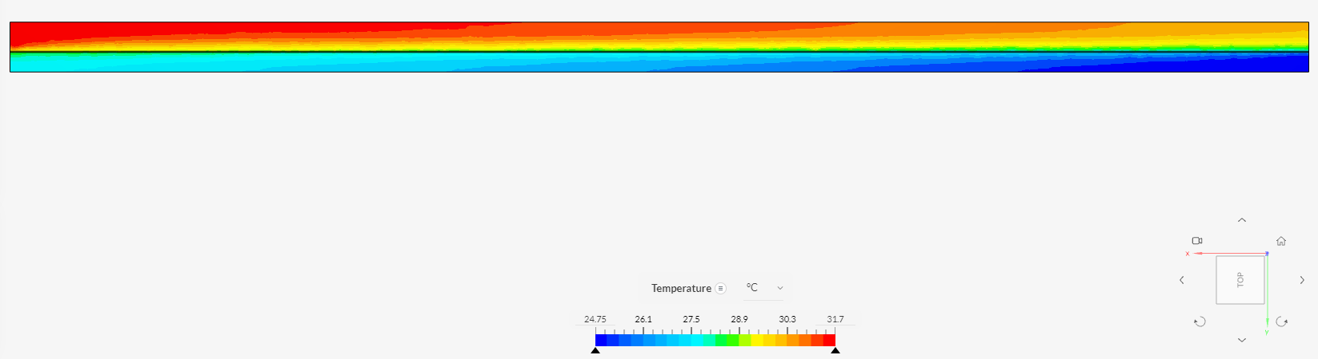
Top View

Slide 37
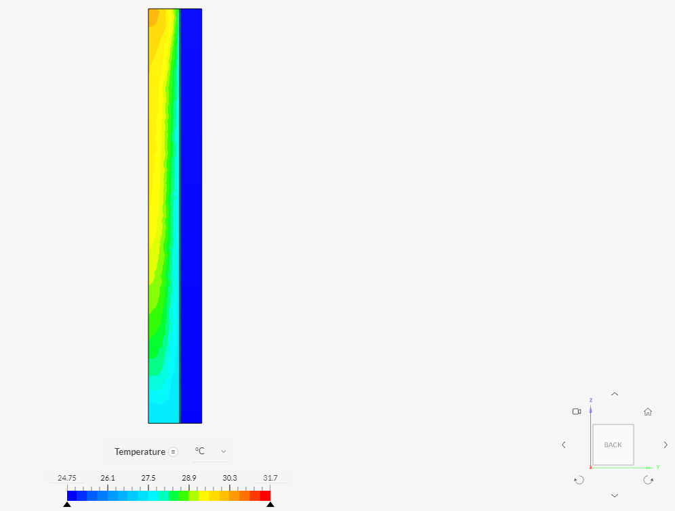
Section at 950mm from Working air Inlet

Slide 38
OBSERVATIONS AND CALCULATIONS
9

Slide 39
OBSERVATIONS AND CALCULATIONS
The Calculation is divided into two parts:
The Evaporative Cooling in the Wet Channel
The heat transfer process between wet and dry channels
Considering,
90% wet bulb effectiveness in wet channel (direct evaporative cooling)
80% heat exchanger efficiency
Supply to working air ratio = 0.5

Slide 40
formulae used
WBE = =
∊_{HE} =
WBT of supply air at inlet
DBT of supply air outlet
W_{i}
D_{o}
T_{h1} - T_{h2}
T_{h1} - T_{c1}

Slide 41
SAMPLE CALCULATION - koparkhairane
Outside Conditions :
24th March 2021 @ 3:00 PM
(DBT _{outside} )_{Koparkhairane} = 33 °C
(WBT _{outside} )_{Koparkhairane}= 21 °C
WBE = 0.9
⇒ Do = 23.33 °C
Tc1= DBT of Working air = 23.33 °C
Th1= DBT of entering supply air = 33 °C
∊_{HE} = 0.8
⇒T_{h2}= 25.264 °C

Slide 42
ANALYSIS
10

Slide 43
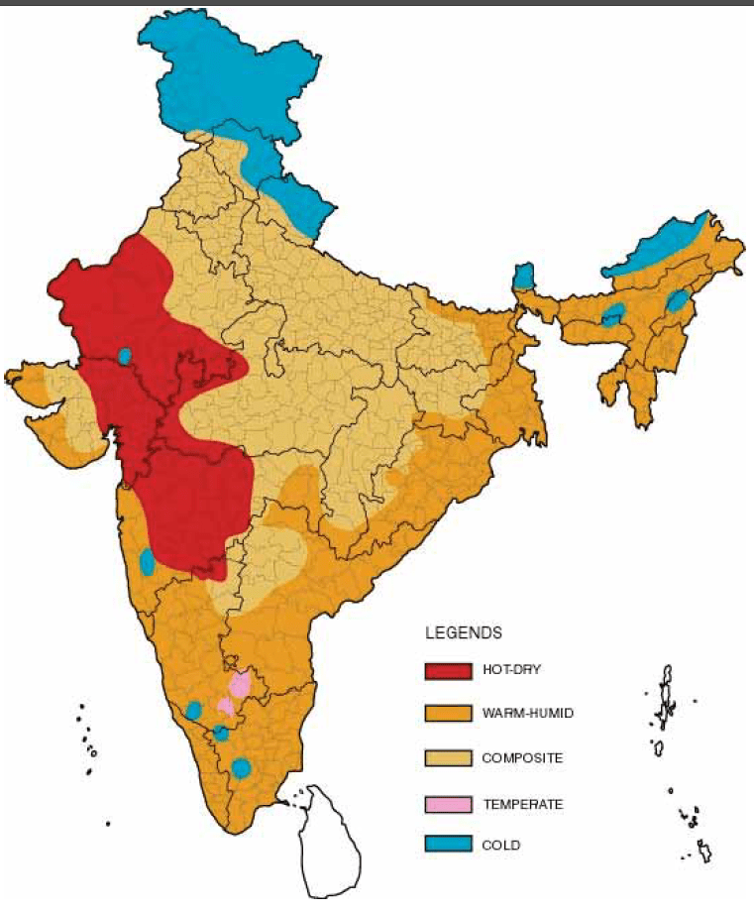
CLIMATE ZONES - INDIA

Slide 44
Climatic Zone | City | Time | DBT | WBT | Achievable DBT |  | Total Achievable Delta T
 |  |  |  |  | In Wet Side | With IEC
Hot and Dry | Ahmedabad | 11:00 AM | 33.6 | 20.1 | 22.33 | 24.59 | 9.01
 |  | 3:00 PM | 38.6 | 21.6 | 24.00 | 26.92 | 11.68
Temperate | Bangalore | 11:00 AM | 27.5 | 16.4 | 18.22 | 20.08 | 7.42
 |  | 3:00 PM | 21.7 | 17.8 | 19.78 | 20.16 | 1.54
Warm and Humid | Mumbai | 11:00 AM | 30.2 | 20.5 | 22.78 | 24.26 | 5.94
 |  | 3:00 PM | 32.2 | 21.1 | 23.44 | 25.20 | 7.00
Composite | Nagpur | 11:00 AM | 34.4 | 18.2 | 20.22 | 23.06 | 11.34
 |  | 3:00 PM | 39.3 | 19.8 | 22.00 | 25.46 | 13.84
*All the temperature values are in ºC
90% wet bulb effectiveness in wet channel
80% heat exchanger efficiency
Month Considered : March
Analysis for various zones

Slide 45
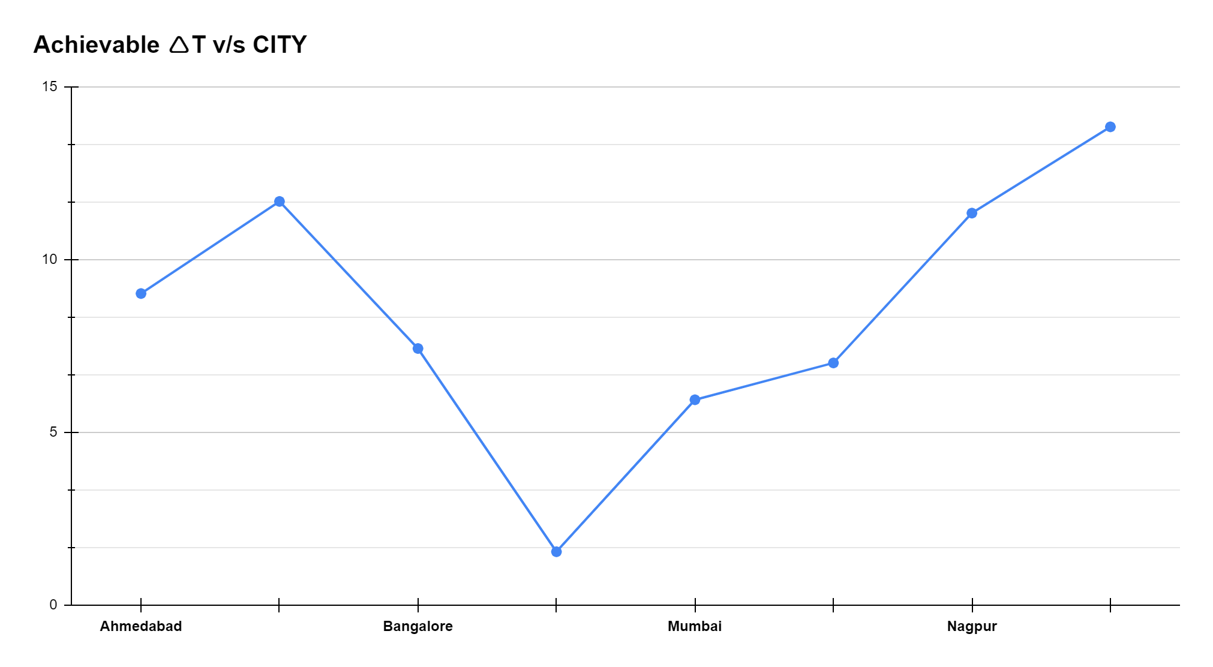
Achievable Delta T v/s CITY

Slide 46
CONCLUSION
11

Slide 47
conclusion
The results obtained from the CFD simulations have differed slightly from the calculated temperatures.
It is expected that a further temperature drop of about 2-4°C can be achieved if the analysis is continued for further more time.
The further methods of optimization of design can be found out by actual experimentation as various factors are approximated in the simulation.

Slide 48
FUTURE SCOPE
12

Slide 49
future scopes
An improved IEC System that can achieve sustainable cooling goals
Reference for commercialization of IEC at household level
A pre-cooler in various air conditioning systems
A system with higher energy saving potential

Slide 50
References
V. Venkateswara Rao and Santanu Prasad Datta, “A feasibility assessment of single to multi/hybrid evaporative coolers for building air-conditioning across diverse climates in India” - Applied Thermal Engineering, Volume 168, 5 March 2020.
Trilok Singh Bisoniya, S.P.S. Rajput and Anil Kumar, “Comparative thermal analysis of theoretical and experimental studies of modified indirect evaporative cooler having cross flow heat exchanger with one fluid mixed and the other unmixed’ - International Journal of Energy and Environment, Volume 2, Issue 5, 2011.
J.K. Jain and D.A. Hindoliya, “Energy saving potential of indirect evaporative cooler under Indian climates” - International Journal of Low-Carbon Technologies, Volume 11, Issue 2, May 2016.
Patent No: US8468846 systems and methods for indirect evaporative cooling and for two stage evaporative cooling
G. P. Maheshwari, F. Al-Ragom and R. K. Suri, “Energy-saving potential of an indirect evaporative cooler”- Applied Energy, Volume 69, Issue 1, May 2001.
Changhong Zhan, Xudong Zhao, Stefan Smith and S. B. Riffat, “Numerical study of a M- cycle cross-flow heat exchanger for indirect evaporative cooling” - Building and Environment, Volume 46, Issue 3, March 2011.

Slide 51
Patent No: US20040061245A1 Indirect evaporative cooling mechanism.
Patent No: WO2016037232A1 Compact indirect evaporative cooler.
Stefano De Antonellis, Cesare Maria Joppolo, Paolo Liberati, Samanta Milani and Francesco Romano, “Modeling and experimental study of an indirect evaporative cooler” -Energy and Buildings, Volume 142, 1 May 2017.
Muhammad Wakil Shahzad, Muhammad Burhan, Doskhan Ybyraiymkul, Seung Jin Oh and Kim Choon Ng, “An improved indirect evaporative cooler experimental investigation” - Applied Energy, Volume 256, 15 December 2019.
https://www.simscale.com/
R.K. Rajput “Heat exchangers” in Heat and Mass Transfer, India: S. Chand, 2015, 574-628.

Slide 52
THANK YOU

